Slide 1
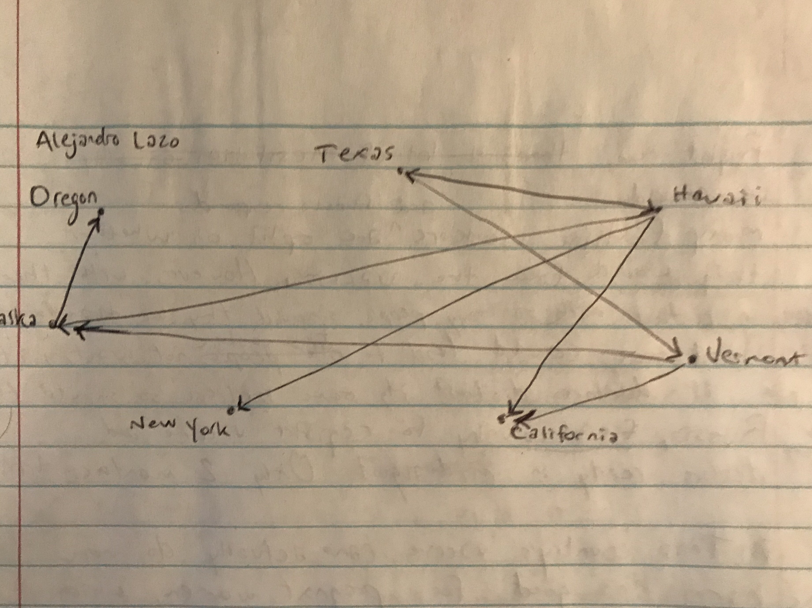
Alejandro Lazo
CMSC 204
CMSC204
Kartchner
V(StateGraph) = {Oregon, Alaska, Texas, Hawaii, Vermont, NewYork, California}
E(StateGraph) = {(Alaska, Oregon), (Hawaii, Alaska), (Hawaii, Texas), (Texas, Hawaii), (Hawaii, California), (Hawaii, New York), (Texas, Vermont), (Vermont, California), (Vermont, Alaska)}
1. Draw the StateGraph

Slide 2
a. Show the adjacency matrix that would describe the edges in the graph. Store the vertices in alphabetical order
States
Alaska, California,Hawaii, New York,Oregon, Texas, Vermont,
Alaska,
California,
Hawaii,
New York,
Oregon,
Texas,
Vermont,
3. b. Show the adjacency lists
that would describe the edges in the graph
Alaska
California
Hawaii
New York
Oregon
Texas
Vermont
{Oregon}
null
{Alaska, California, New York, Texas}
null
null
{Hawaii, Vermont}
{Alaska, California}

Slide 3
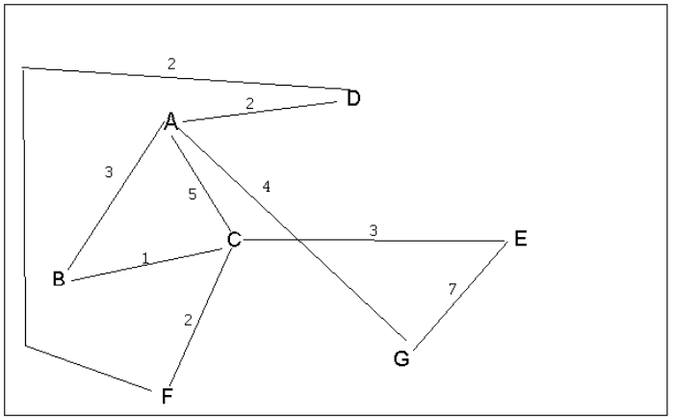
4 a. Which of the following lists the graph nodes in depth first order beginning with E?
A) E, G, F, C, D, B, A
B) G, A, E, C, B, F, D
C) E, G, A, D, F, C, B
D) E, C, F, B, A, D, G
4 b. Which of the following lists the graph nodes in breadth first order beginning at F?
A) F, C, D, A, B, E, G
B) F, D, C, A, B, C, G
C) F, C, D, B, G, A, E
D) a, b, and c are all breadth first traversals

Slide 4
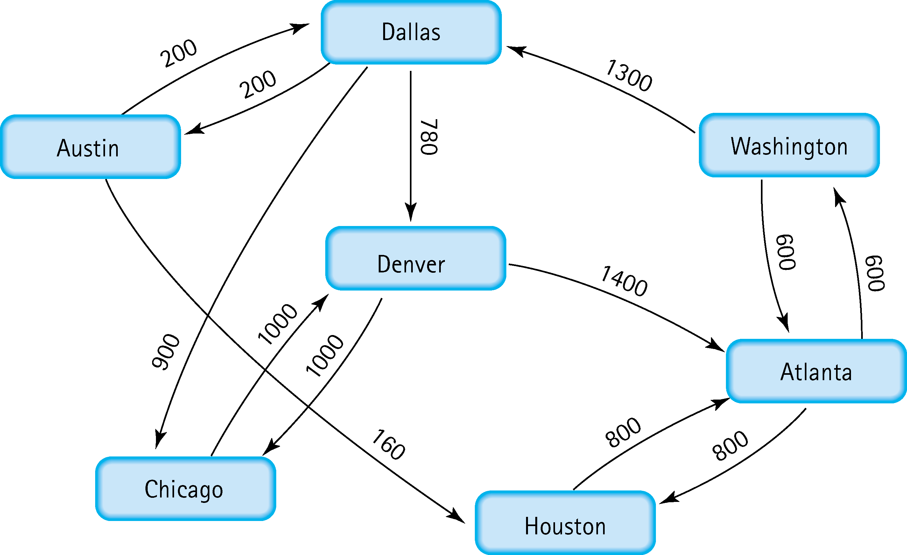
5. Find the shortest distance from Atlanta to every other city
Atlanta – Washtington : 600
Atlanta – Houston : 800
Atlanta – Washington – Dallas : 1900
Atlanta – Washington – Dallas – Denver : 2680
Atlanta – Washington – Dallas – Austin : 2100
Atlanta – Washington – Dallas – Chicago : 2800

Slide 5
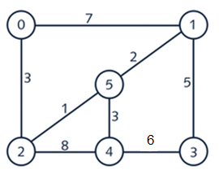







6. Find the minimal spanning tree using Prim’s algorithm. Use
0 as the source vertex . Show the steps.
Visited = {0}
Visited = {0, 2}
Visited = {0, 2, 5}
Visited = {0, 2, 5, 1}
Visited = {0, 2, 5, 1, 4}
Visited = {0, 2, 5, 1, 4, 3}

Slide 6


7. Find the minimal spanning tree using Kruskal’s algorithm.
Show the weights in order and the steps.
Looking for paths with the least weight, avoiding loops
Path = {(2,5)} because lowest weight of 1
Path = {(2,5), (5,1)} because lowest weight of 2
Path = {(0,2), (2,5), (5,1)} because weight of 3
Path = {(0,2), (2,5), (5,1), (5,4)} because weight of 3
Path = {(0,2), (2,5), (5,1), (1,3), (5,4)} because weight of 5

Slide 7
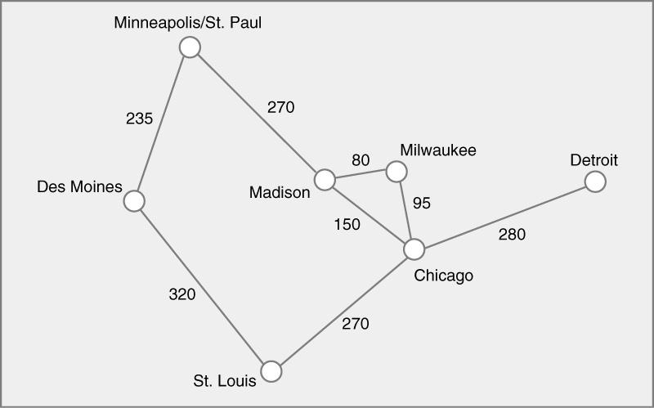




8. Find the minimal spanning tree using the algorithm you prefer. Use
Minneapolis/St. Paul as the source vertex
Visited = {Minneapolis}
Visited = {Minneapolis, Des Moines}
Visited = {Minneapolis, Des Moines, Madison}
Visited = {Minneapolis, Des Moines, Madison, Milwaukee}
Visited = {Minneapolis, Des Moines, Madison, Milwaukee, Chicago}
Visited = {Minneapolis, Des Moines, Madison, Milwaukee, Chicago, St. Louis}
Visited = {Minneapolis, Des Moines, Madison, Milwaukee, Chicago, St. Louis, Detroit}

Slide 8
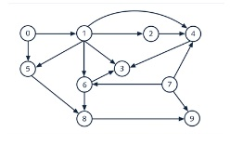
9. List the nodes of the graph in a breadth first topological ordering. Show the
steps using arrays predCount, topologicalOrder and a queue
[0] [1] [2] [3] [4] [5] [6] [7] [8] [9]
predCount
topOrder
queue
0 | 1 | 1 | 3 | 3 | 2 | 2 | 0 | 2 | 2
0 | 7
[0] [1] [2] [3] [4] [5] [6] [7] [8] [9]
- | 0 | 1 | 3 | 2 | 1 | 1 | - | 2 | 1
0 | 7

Slide 9
[0] [1] [2] [3] [4] [5] [6] [7] [8] [9]
- | - | 0 | 2 | 1 | 0 | 0 | - | 2 | 1
0 | 7 | 1
[0] [1] [2] [3] [4] [5] [6] [7] [8] [9]
- | - | - | 1 | 0 | - | - | - | 0 | 1
0 | 7 | 1 | 2 | 5 | 6
[0] [1] [2] [3] [4] [5] [6] [7] [8] [9]
- | - | - | 0 | - | - | - | - | - | 0
0 | 7 | 1 | 2 | 5 | 6 | 4 | 8
[0] [1] [2] [3] [4] [5] [6] [7] [8] [9]
predCount
topOrder
queue
- | - | - | - | - | - | - | - | - | -
0 | 7 | 1 | 2 | 5 | 6 | 4 | 8 | 3 | 9
0 | 7 | 1 | 2 | 5 | 6 | 4 | 8 | 3 | 9
So the final topological order is
0 | 7 | 1 | 2 | 5 | 6 | 4 | 8 | 3 | 9

Slide 10
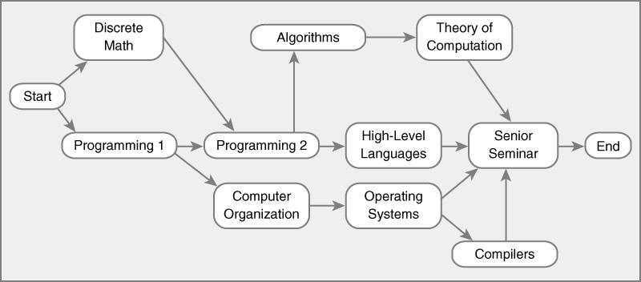
10. List the nodes of the graph in a breadth first topological ordering.
Progr.
1
Algorithms
Comp.
Organiz.
Theory of
Comput.
Start
Discrete Math
Progr.
2
High-Lvl
Lang.
Senior
Seminar
Operat.
Systems
Compil-ers
End
predCount
topOrder
queue
0 | 1 | 1 | 2 | 1 | 1 | 1 | 1 | 4 | 1
1 | 1
Progr.
1
Algorithms
Comp.
Organiz.
Theory of
Comput.
Start
Discrete Math
Progr.
2
High-Lvl
Lang.
Senior
Seminar
Operat.
Systems
Compil-ers
End
- | 0 | 0 | 2 | 1 | 1 | 1 | 1 | 4 | 1
1 | 1
Start

Slide 11
Progr.
1
Algorithms
Comp.
Organiz.
Theory of
Comput.
Start
Discrete Math
Progr.
2
High-Lvl
Lang.
Senior
Seminar
Operat.
Systems
Compil-ers
End
- | - | - | 0 | 1 | 1 | 0 | 1 | 4 | 1
1 | 1
Start | Disc. Math | Prog. 1
Progr.
1
Algorithms
Comp.
Organiz.
Theory of
Comput.
Start
Discrete Math
Progr.
2
High-Lvl
Lang.
Senior
Seminar
Operat.
Systems
Compil-ers
End
- | - | - | - | 0 | 0 | - | 1 | 4 | 0
1 | 1
Start | Disc. Math | Prog. 1 | Prog. 2 | Com Orga
Progr.
1
Algorithms
Comp.
Organiz.
Theory of
Comput.
Start
Discrete Math
Progr.
2
High-Lvl
Lang.
Senior
Seminar
Operat.
Systems
Compil-ers
End
- | - | - | - | - | - | - | 0 | 2 | -
0 | 1
Start | Disc. Math | Prog. 1 | Prog. 2 | Com Orga | Algorith. | Hi-lv Lang | Op. Syst.
Progr.
1
Algorithms
Comp.
Organiz.
Theory of
Comput.
Start
Discrete Math
Progr.
2
High-Lvl
Lang.
Senior
Seminar
Operat.
Systems
Compil-ers
End
- | - | - | - | - | - | - | - | 0 | -
- | 1
Start | Disc. Math | Prog. 1 | Prog. 2 | Com Orga | Algorith. | Hi-lv Lang | Op. Syst. | Theo Com | Compiler

Slide 12
Progr.
1
Algorithms
Comp.
Organiz.
Theory of
Comput.
Start
Discrete Math
Progr.
2
High-Lvl
Lang.
Senior
Seminar
Operat.
Systems
Compil-ers
End
- | - | - | - | - | - | - | - | - | -
- | 0
Start | Disc. Math | Prog. 1 | Prog. 2 | Com Orga | Algorith. | Hi-lv Lang | Op. Syst. | Theo Com | Compiler
Sen Sem
Progr.
1
Algorithms
Comp.
Organiz.
Theory of
Comput.
Start
Discrete Math
Progr.
2
High-Lvl
Lang.
Senior
Seminar
Operat.
Systems
Compil-ers
End
- | - | - | - | - | - | - | - | - | -
- | -
Start | Disc. Math | Prog. 1 | Prog. 2 | Com Orga | Algorith. | Hi-lv Lang | Op. Syst. | Theo Com | Compiler
Sen Sem | End
Start | Disc. Math | Prog. 1 | Prog. 2 | Com Orga | Algorith. | Hi-lv Lang | Op. Syst. | Theo Com | Compiler
Sen Sem | End
So the final topological order is
Discrete Math
Computer
Organiz.
 | End
Start
Progr.
1
Progr.
2
Algorithms
High-Lvl
Lang.
Operating
Systems
Theory of
Comput.
Compilers
Senior
Seminar

